Slide 1
Project Title: Dropout Risk Detection
Student Name:
Angel Xavier-01
Taanshu Babariya-03
Mariam Badure-04
Jaden Borges-08
Batch: A1
Course: ML Mini Project
Guide Name: Dr. Joanne Gomes
Institute Name: St. Francis Institute of Technology

Slide 2
Problem Recap
Phase 1 identified that many students drop out due to low academic performance and lack of engagement.
However, the baseline model had limitations in accuracy due to class imbalance and limited model complexity.
Institutes require a more reliable and accurate system to identify at-risk students early.
In Phase 2, the focus is on improving prediction performance using advanced machine learning models and imbalance handling techniques.
Goal: build a more accurate and robust prediction model to support early intervention.

Slide 3
Dataset (Final)
Dataset Source
Name: Predict Students' Dropout and Academic Success
Source: Kaggle / UCI Machine Learning Repository
Number of Samples
Rows (instances): 4,424 students
Features: 36 input features + 1 target column
Feature Description
The dataset includes student demographic, academic, financial, family, and economic details.
Demographic: gender, age, nationality
Academic: course, previous grades, semester performance
Financial: fees status, scholarship, debtor
Family: parents’ education & occupation
Economic: unemployment, inflation, GDP

Slide 4
Data Pre-processing
Handling Missing Values
No missing values
Dataset is already cleaned and ready to use
Encoding Categorical Variables
No additional encoding required
All categorical fields are already label encoded as numeric values
Features can be directly used for ML models
Normalization / Scaling
Use StandardScaler
Important for Logistic Regression, SVM, DNN
Less important for tree-based models

Slide 5
Feature Engineering
Selected Features
Personal: age, gender, marital status, nationality, international
Academic background: previous qualification, application mode/order
Semester performance: enrolled, approved units, grades, evaluations
Financial/social: fees status, debtor, scholarship, course
Economic/family: unemployment, inflation, GDP, parents’ education
Justification
Semester approved units + grades → strongest academic predictors
Tuition fees, debtor, scholarship → financial stress indicators
Age and family background → personal support & responsibility factors
Economic indicators → external stress on continuation
Domain Knowledge Used
Low grades → poor academic progress
Fee delays → financial hardship
Scholarship → higher motivation
Older/married students → more outside responsibilities

Slide 6
Models Implemented
Algorithms Shortlisted
Logistic Regression
Random Forest
Gradient Boosting
Reason for Choosing Each
Logistic Regression: simple, fast, and strong baseline classifier
Random Forest: handles non-linearity, reduces overfitting, gives feature importance
Gradient Boosting: high accuracy by learning from previous model errors

Slide 7
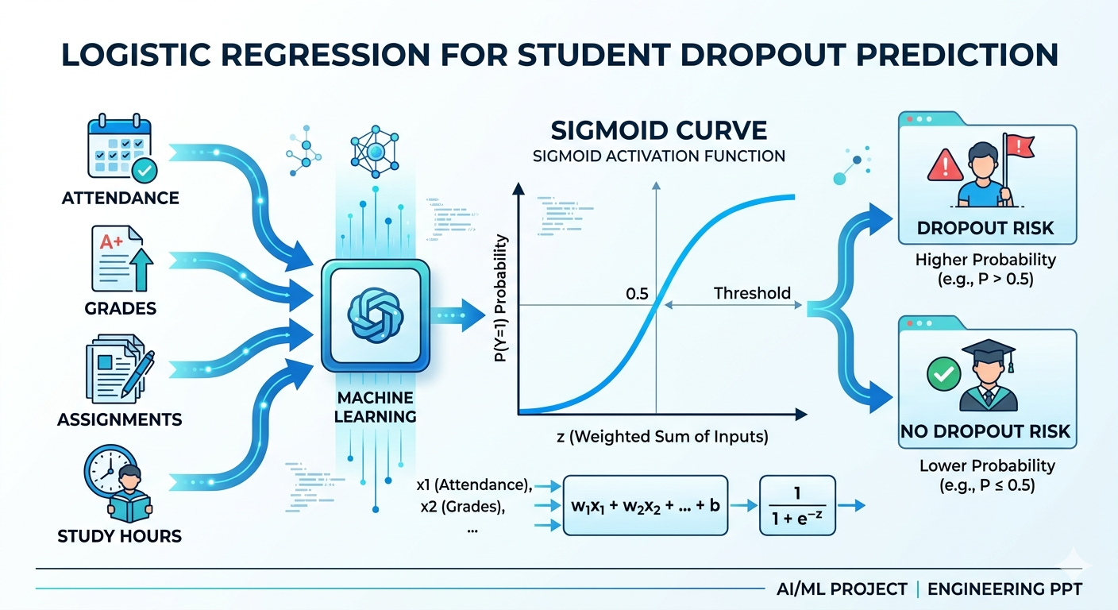
Brief description of each (diagram)
Logistic Regression

Slide 8
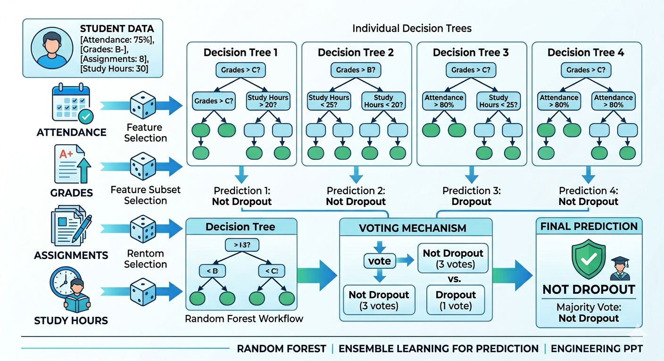
Random Forest

Slide 9
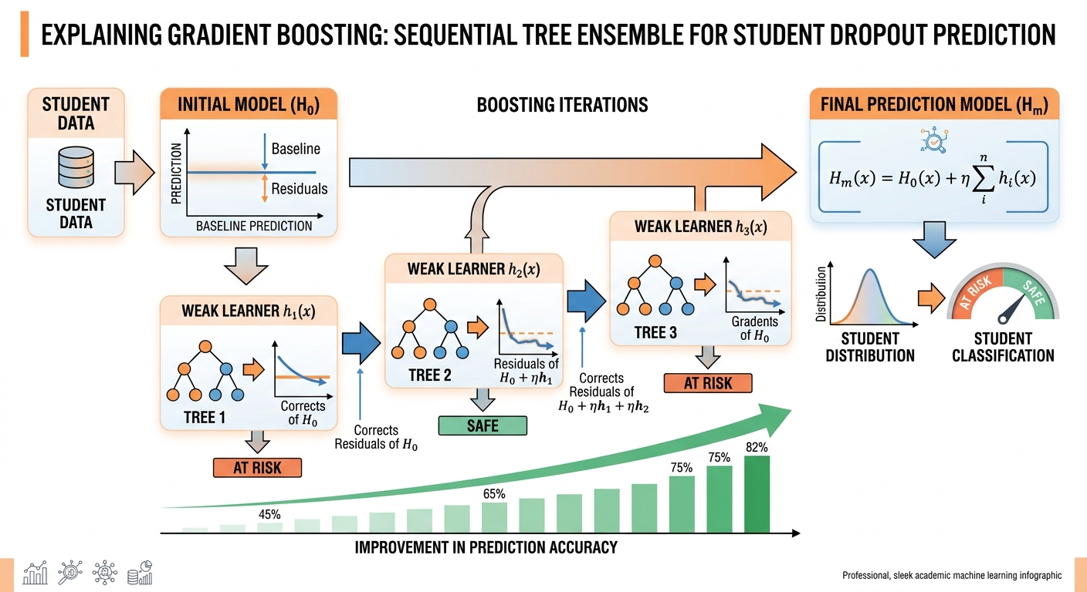
Gradient Boosting

Slide 10
Hyperparameter Tuning
Parameters Tuned
For Random Forest, the following parameters were tuned:
n_estimators → [100, 200]
max_depth → [None, 10, 20]
For Gradient Boosting, default:
n_estimators = 100
For Logistic Regression:
max_iter = 1000

Slide 11
Method Used
GridSearchCV was used for Random Forest
Manual/default tuning was used for Logistic Regression and Gradient Boosting
3-fold cross-validation
F1-score used as scoring metric
Effect on Performance
Random Forest performance improved after tuning
Better balance between precision and recall
F1-score improved to 81.02%
Gradient Boosting still achieved the best F1-score (82.14%)
Helped in selecting the best final model

Slide 12
Evaluation Metrics and Model Comparison
Model | Accuracy | Precision | Recall | F1 Score
Logistic Regression | 87.46% | 78.36% | 84.15% | 81.15%
Random Forest | 88.25% | 84.09% | 78.17% | 81.02%
Gradient Boosting | 88.70% | 83.33% | 80.99% | 82.14%

Slide 13
Best Model Selection
Selected model: Gradient Boosting
Reason for selection:
It achieved the highest accuracy (88.70%)
It has the best F1-score (82.14%), which means the best balance between precision and recall
Precision and recall are both strong, making it reliable for identifying at-risk students
Performs better than Logistic Regression and Random Forest overall
Works well on complex patterns and feature interactions
Suitable for student dropout prediction, where balanced classification is important

Slide 14
Error Analysis
Where model fails:
Borderline students → students whose behavior is between dropout and non-dropout
Sudden life events → personal, financial, or health issues not present in the dataset
Incomplete data → missing attendance, grades, or assignment records
Noisy data → incorrect or inconsistent student information
Unseen patterns → new types of student behavior not learned during training
Class imbalance issues → minority dropout cases may still be harder to predict
Example misclassifications
A student is predicted as “Safe”, but actually drops out.
Example:
Good attendance and grades initially
Suddenly faces financial or personal issues
Leaves college unexpectedly
Model fails because these hidden factors were not in training data.

Slide 15
Improvement over Phase-1
Previous vs current performance
Phase | Model | Accuracy | Precision | Recall | F1 Score
Phase 1 | Logistic Regression (Baseline Model) | 88.02% | 87.39% | 73.24% | 79.69%
Phase 2 | Logistic Regression + SMOTE | 87.46% | 78.36% | 84.15% | 81.15%
Phase 2 | Random Forest (Tuned) | 88.25% | 84.09% | 78.17% | 81.02%
Phase 2 | Gradient Boosting | 88.70% | 83.33% | 80.99% | 82.14%

Slide 16
What improved results
Higher F1-score improved from 79.69% → 82.14%
Better recall improved from 73.24% → 84.15% (LR+SMOTE)
Better handling of class imbalance using SMOTE
Ensemble models improved overall generalization
Gradient Boosting gave the best balanced performance
Better identification of dropout-risk students

Slide 17
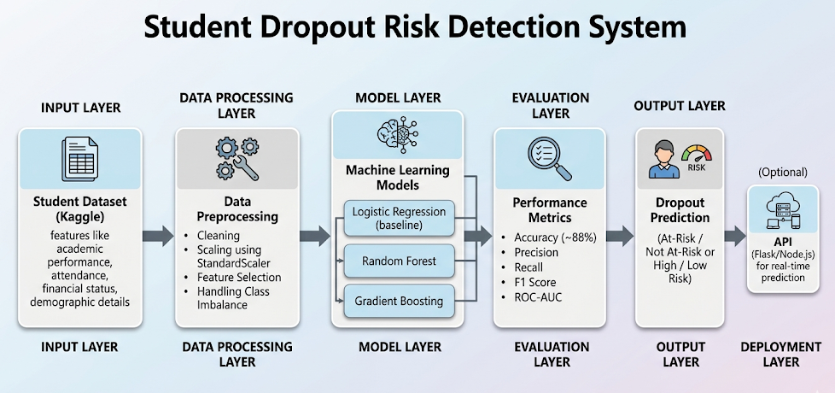
System Integration
Input → Processing → Model → Output

Slide 18
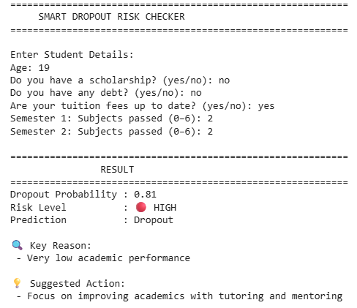
Demo / Results

Slide 19
Challenges Faced
• Understanding dataset features and their meaning
• Handling class imbalance in dropout data
• Selecting the most relevant features
• Choosing appropriate ML models
• Improving recall for dropout prediction

Slide 20
Future Work
Future Work
Use larger and multi-college datasets
Add more features like financial and behavioral data
Try advanced models like XGBoost / LightGBM
Deploy as a real-time dashboard or web app
Use Explainable AI for better trust
Possible Improvements
Better hyperparameter tuning
Reduce false negatives
Improve feature engineering
Add real-time monitoring

Slide 21
Phase-2 Deliverables
Deliverable 1: Cleaned dataset
Deliverable 2: Jupyter Notebook
Deliverable 3: Code Repository (GitHub)
https://github.com/angelxavier905/AIML_ML-Lab/tree/main/ML_Mini
Deliverable 4: System Integration Proof

Slide 22
References
• Kaggle Dataset: Predict Students’ Dropout and Academic Success
• Villar & Andrade (2024) – Discover AI
• Marcolino et al. (2025) – Scientific Reports
• Cho et al. (2023) – Applied Sciences
• Kim et al. (2023) – Applied Sciences

